Slide 1
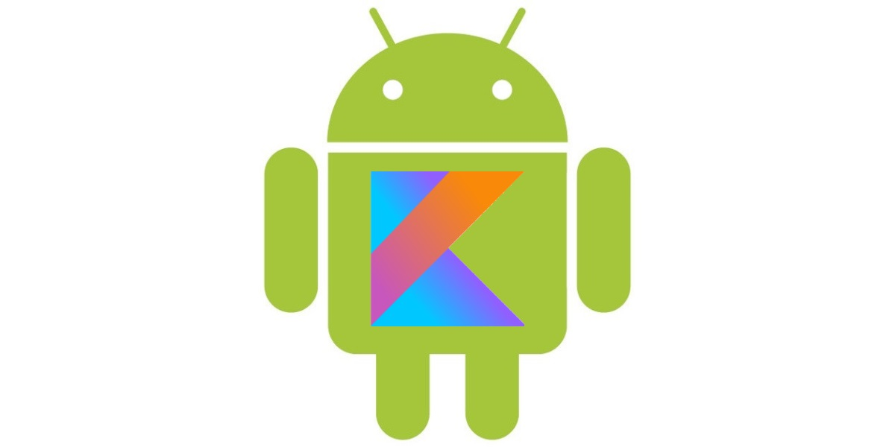
MOOCS
ANDROID DEVELOPMENT WITH KOTLIN

Slide 2

What is Kotlin in Android
Kotlin is a general purpose, free, open source, statically typed “pragmatic” programming language initially designed for the JVM (Java Virtual Machine) and Android and combines object-oriented and functional programming features.
Kotlin originated at JetBrains, the company behind IntelliJ IDEA, in 2010, and has been open source since 2012.
The Kotlin project on GitHub has more than 770 contributors while most of the team works at JetBrains, there have been nearly 100 external contributors to the Kotlin project.
JetBrains uses Kotlin in many of its products including its flagship IntelliJ IDEA.

Slide 3
Features of Kotlin
Concise: Kotlin reduces writing the extra codes. This makes Kotlin more concise.
Null safety: Kotlin is null safety language. Kotlin aimed to eliminate the NullPointerException (null reference) from the code.Interoperable.
Interoperable: Kotlin easily calls the Java code in a natural way as well as Kotlin code can be used by Java.
Smart cast: It explicitly typecasts the immutable values and inserts the value in its safe cast automatically.
Compilation Time: It has better performance and fast compilation time.
Tool-friendly: Kotlin programs are build using the command line as well as any of Java IDE.
Extension function: Kotlin supports extension functions and extension properties which means it helps to extend the functionality of classes without touching their code.

Slide 4
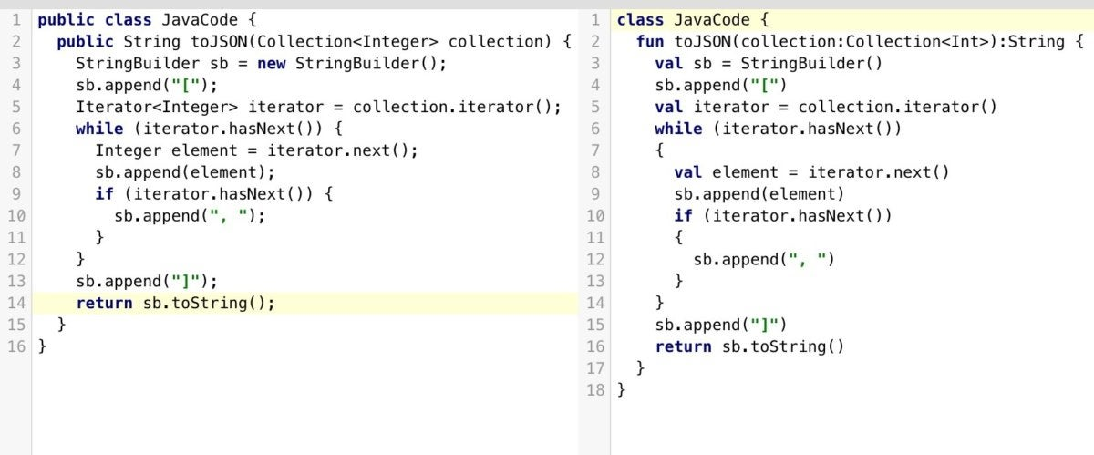
Kotlin as a more concise Java language
At first glance, Kotlin looks like a more concise and streamlined version of Java. Consider the screenshot, where I have converted a Java code sample (at left) to Kotlin automatically. Notice that the mindless repetition inherent in instantiating Java variables has gone away.

Slide 5
You can see that functions are defined with the fun keyword, and that semicolons are now optional when newlines are present. The Val keyword declares a read-only property or local variable. Similarly, the var keyword declares a mutable property or local variable.
Nevertheless, Kotlin is strongly typed. The Val and var keywords can be used only when the type can be inferred. Otherwise, you need to declare the type. Type inference seems to be improving with each release of Kotlin.
Have a look at the function declaration near the top of both panes. The return type in Java precedes the prototype, but in Kotlin it succeeds the prototype, demarcated with a colon as in Pascal.
Becomes
StringBuilder sb = new StringBuilder();
val sb = StringBuilder()

Slide 6
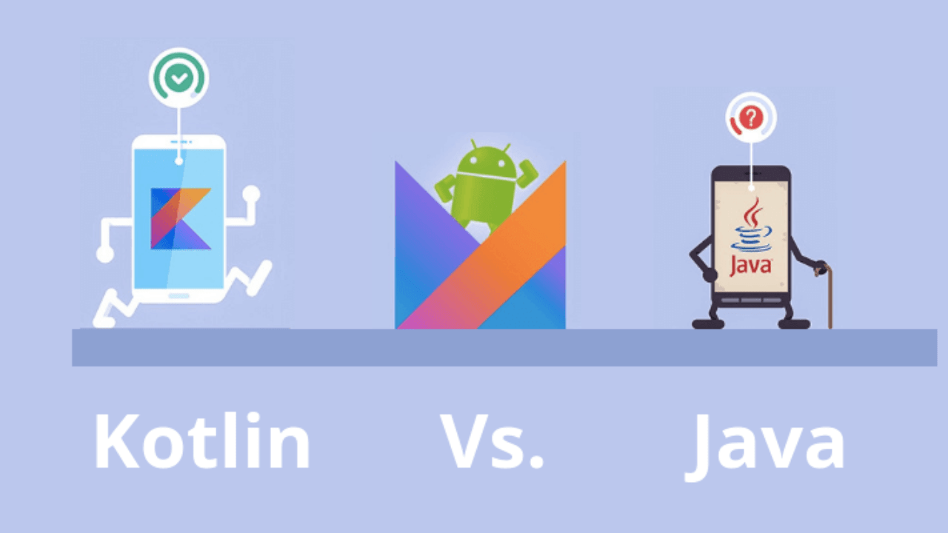
The question of whether to choose Kotlin or Java for new development has been coming up a lot in the Android community since the Google I/O announcement, although people were already asking the question in February 2016 when Kotlin 1.0 shipped. The short answer is that Kotlin code is safer and more concise than Java code, and that Kotlin and Java files can coexist in Android apps, so that Kotlin is not only useful for new apps, but also for expanding existing Java apps. The only cogent argument I have seen for choosing Java over Kotlin would be for the case of complete Android development newbies. For them, there might be a barrier to surmount given that, historically, most Android documentation and examples are in Java. On the other hand, converting Java to Kotlin in Android Studio is a simple matter of pasting the Java code into a Kotlin file. In 2022, six years after Kotlin 1.0, I’m not sure this documentation or example barrier still exists in any significant way.
Kotlin vs. Java

Slide 7

Kotlin for Jetpack Compose
Jetpack Compose is a modern toolkit for building Android UIs. Compose simplifies and accelerates UI development on Android with less code, powerful tools, and intuitive Kotlin capabilities. With Compose, you can build your UI by defining a set of functions, called composable functions, that take in data and emit UI elements.
Composable functions
Composable functions are the basic building block of a UI in Compose. A composable function:
Describes some part of your UI.
Doesn't return anything.
Takes some input and generates what's shown on the screen.
Might emit several UI elements.

Slide 8
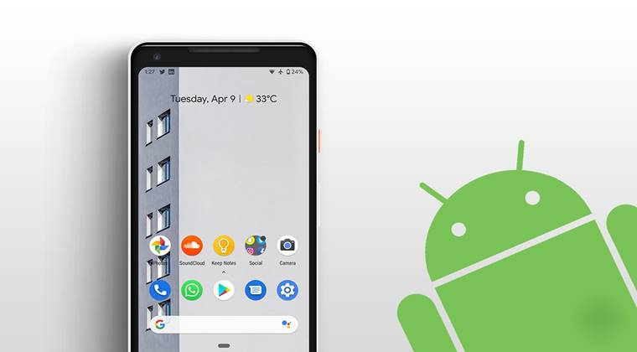
ANDROID QUIZ APP
This Photo by Unknown Author is licensed under CC BY-NC-ND

Slide 9
android_main.xml
<?xml version="1.0" encoding="utf-8"?>
<androidx.constraintlayout.widget.ConstraintLayout xmlns:android="http://schemas.android.com/apk/res/android" xmlns:app="http://schemas.android.com/apk/res-auto"
xmlns:tools="http://schemas.android.com/tools"
android:layout_width="match_parent"
android:layout_height="match_parent"
tools:context=".MainActivity">
<TextView
android:id="@+id/textView2"
android:layout_width="wrap_content"
android:layout_height="wrap_content"
android:text="Android Quiz!"
android:textSize="20sp"
app:layout_constraintBottom_toBottomOf="parent"
app:layout_constraintHorizontal_bias="0.498"
app:layout_constraintLeft_toLeftOf="parent"
app:layout_constraintRight_toRightOf="parent"
app:layout_constraintTop_toTopOf="parent"
app:layout_constraintVertical_bias="0.117" />

Slide 10
<TextView
android:id="@+id/textView"
android:layout_width="200dp"
android:layout_height="wrap_content"
android:text="What are the two official languages for Android development? \n\n A) Kotlin and Java \n\n B) Java and Python \n\n C) Kotlin and Python"
android:textSize="11sp"
app:layout_constraintBottom_toTopOf="@+id/button"
app:layout_constraintEnd_toEndOf="parent"
app:layout_constraintHorizontal_bias="0.498"
app:layout_constraintStart_toStartOf="parent"
app:layout_constraintTop_toBottomOf="@+id/textView2"
app:layout_constraintVertical_bias="0.083" />
<Button
android:id="@+id/button"
android:layout_width="wrap_content"
android:layout_height="wrap_content"
android:layout_marginStart="32dp"
android:text="A"
app:layout_constraintBottom_toBottomOf="parent"
app:layout_constraintStart_toStartOf="parent"
app:layout_constraintTop_toTopOf="parent"
app:layout_constraintVertical_bias="0.674" />

Slide 11
<Button
android:id="@+id/button2"
android:layout_width="wrap_content"
android:layout_height="wrap_content"
android:layout_marginStart="40dp"
android:text="B"
app:layout_constraintBottom_toBottomOf="parent"
app:layout_constraintStart_toEndOf="@+id/button"
app:layout_constraintTop_toTopOf="parent"
app:layout_constraintVertical_bias="0.674" />
<Button
android:id="@+id/button3"
android:layout_width="wrap_content"
android:layout_height="wrap_content"
android:text="C"
app:layout_constraintBottom_toBottomOf="parent"
app:layout_constraintEnd_toEndOf="parent"
app:layout_constraintHorizontal_bias="0.472"
app:layout_constraintStart_toEndOf="@+id/button2"
app:layout_constraintTop_toTopOf="parent"
app:layout_constraintVertical_bias="0.674" />
</androidx.constraintlayout.widget.ConstraintLayout>

Slide 12
mainActivity.kt
package com.example.myapplicationkotlin
import androidx.appcompat.app.AppCompatActivity
import android.os.Bundle
import android.widget.Button
import android.widget.TextView
import android.widget.Toast
class MainActivity : AppCompatActivity() {
var questionNo = 0
var questions = listOf("What are the two official languages for Android development? \n\n A) Kotlin and Java \n\n B) Java and Python \n\n C) Kotlin and Python", "How do you define a function in Kotlin? \n\n A) void \n\n B) var \n\n C) function", "What is a variable used for? \n\n A) To contain data \n\n B) To insert a random value \n\n C) Don't know", "What does SDK stand for in Android SDK? \n\n A) Software Development Kit \n\n B) Software Development Kotlin \n\n C) Something Don't Know")
var rightAnswers = listOf(1, 2, 1, 1)
override fun onCreate(savedInstanceState: Bundle?) {
super.onCreate(savedInstanceState)
setContentView(R.layout.activity_main)
val button: Button = findViewById(R.id.button)
button.setOnClickListener { showToast(1) }
val button2: Button = findViewById(R.id.button2)
button2.setOnClickListener { showToast(2) }
val button3: Button = findViewById(R.id.button3)
button3.setOnClickListener { showToast(3) } }

Slide 13
fun showToast(answer : Int)
{
if (answer==rightAnswers.get(questionNo))
{
Toast.makeText(applicationContext, "CORRECT!", Toast.LENGTH_SHORT).show() updateQuestion()
}
else
{
Toast.makeText(applicationContext, "WRONGO!", Toast.LENGTH_SHORT).show()
}
}
fun updateQuestion() {
questionNo = questionNo + 1
val textView: TextView = findViewById(R.id.textView) textView.setText(questions.get(questionNo))
}
}

Slide 14
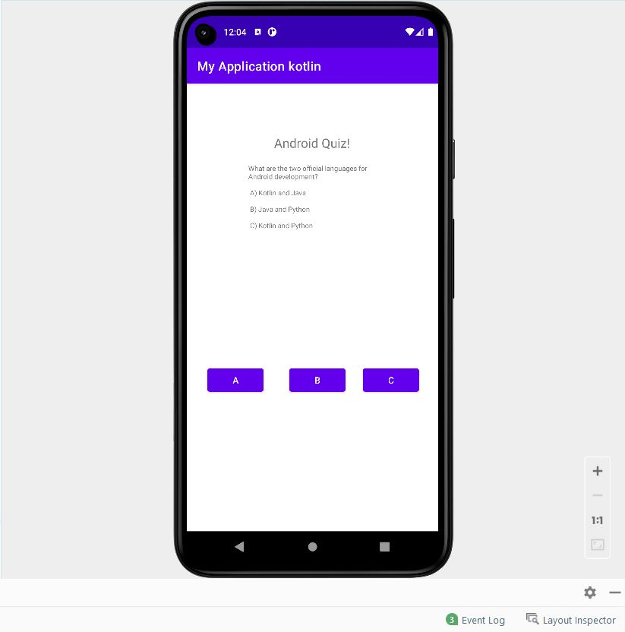

Slide 15
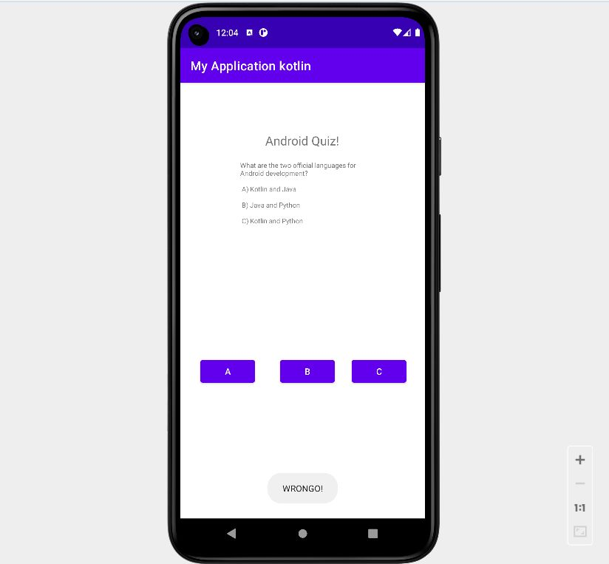
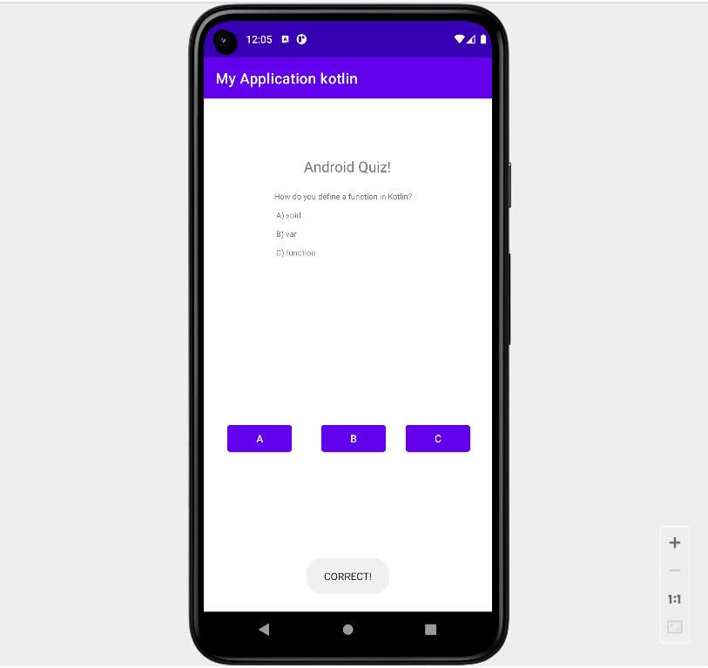

Slide 16
Thank you!!!
Name-Gurpreet Kaur Jassal
Stdid-20042126 (55)
University RollNo-2021082
Course-BCA Sec- ‘A’
Semester-5

